Slide 1
Alexander Wake – Interview Project 31/01/2025
https://github.com/AWake01/Interview-Project

Slide 2
Tools/Libraries
Python
PyCharm Community Edition IDE
Regex – Patten matching used to decode commands.
Pandas – Draw table for debug display of sensor objects.

Slide 3
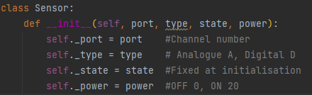
Implementation
All devices (analogue/digital, input/output) modelled as a single sensor class.
State represents the sensor input value, and power represents the output device and device power state.
Sensor readings are fixed at initialisation.

Slide 4
Model-View-Controller communication
main.py:
Create instances of BoardModel, BoardView and BoardController classes.
Starts view user input cycle.
Python Command Line Terminal
User input:
E 12
Output:
E 12 OK_
model.py:
Simulation of physical control board.
Provides BoardModel class
Initialises required sensors.
Decodes command and determines correct operation.
Gets mock sensor readings.
Processes command.
Constructs response string.
Converts response string to command.
Returns command to model.
view.py:
Provides BoardView class
Send request to controller.
Display reply as output.
Response:
^E 12 OK_\n
Reply:
E 12 OK_
controller.py:
Provides BoardController class
Would sit on server.
Receive user input from view
Convert request to command.
Send command to model.
Receive response from model.
Convert response to reply string.
Send reply to
Command:
^E 12\n
Request:
E 12

Slide 5
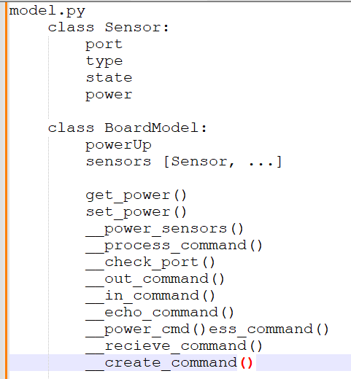
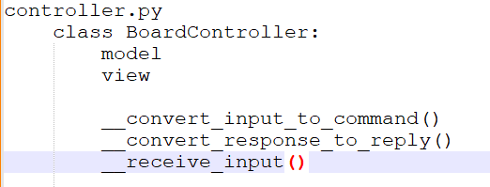
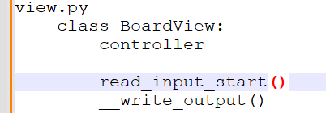
Classes

Slide 6
Improvements
Create separate devices for input and output via abstraction/inheritance.
Allow for devices to be added via view.
Add GUI to view using a package like PyQt.
Simulate communication between model-view-controller via HTTP (API) or sockets.

Slide 7
https://www.datacamp.com/tutorial/a-complete-guide-to-socket-programming-in-python
https://www.pythonguis.com/tutorials/creating-your-first-pyqt-window/
https://www.pythonguis.com/tutorials/pyqt-basic-widgets/
https://realpython.com/python-pyqt-layout/
https://stackoverflow.com/questions/16069713/pyqt-window-closes-immediately-after-opening

